Slide 1
Project 2: Capstone Engagement
Assessment, Analysis, and Hardening of a Vulnerable System

Slide 2
Table of Contents
This document contains the following sections:
01
Network Topology
02
Red Team: Security Assessment
03
Blue Team: Log Analysis and Attack Characterization
Hardening: Proposed Alarms and Mitigation Strategies
04

Slide 3
Network Topology
‹#›

Slide 4
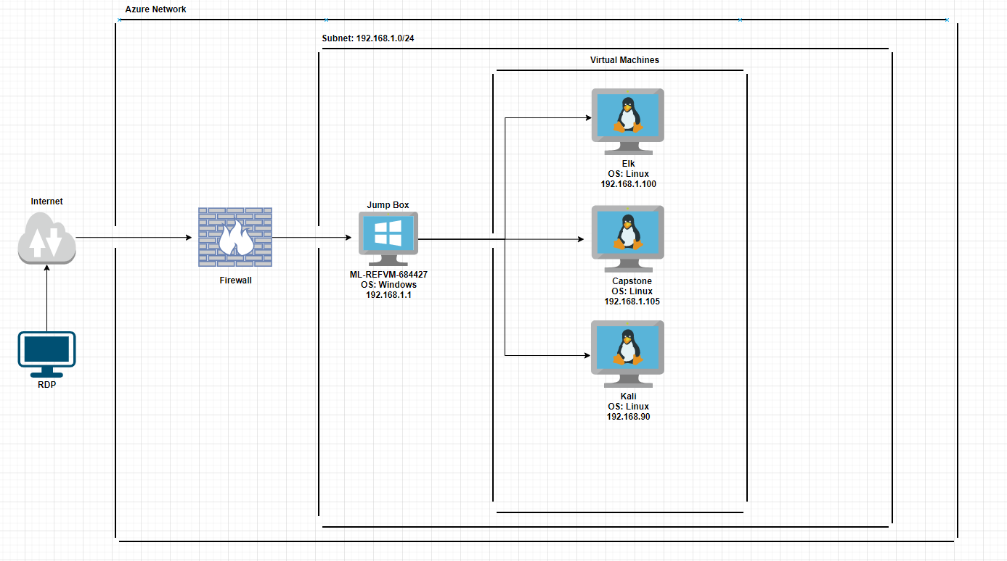
Network Topology
Network
Address Range:192.168.1.0/24
Netmask:255.255.255.0
Gateway:192.168.1.1
Machines
IPv4:192.168.1.1
OS:Windows
Hostname:ML-REFVM-684427
IPv4:192.168.1.100
OS:Linux
Hostname:Elk
IPv4:192.168.1.105
OS:Linux
Hostname:Capstone
IPv4:192.168.1.90
OS:Linux
Hostname:Kali

Slide 5

Red Team
Security Assessment
‹#›

Slide 6
Recon: Describing the Target
Nmap identified the following hosts on the network:
Hostname | IP Address | Role on Network
ML-REFVM-684427 | 192.168.1.1 | Host Machine
Elk | 192.168.1.100 | SIEM, Gathers Logs
Capstone | 192.168.1.105 | Web Server, Target Machine
Kali | 192.168.1.90 | Penetration Tester, Attack Machine

Slide 7
Vulnerability Assessment
The assessment uncovered the following critical vulnerabilities in the target:
Vulnerability | Description | Impact
Use the CVE number if it exists. Otherwise, use the common name. | Describe the vulnerability. | Describe what this vulnerability allows the attacker to do.
Brute Force Vulnerability | User passwords were weak and vulnerable to attack. An attack was done to find out the password for user ashton. | This allowed us to login in as ashton and access the secret_folder directory.
Reverse Shell Backdoor | Able to send a reverse shell payload to webdav to establish a persistent connection. | This allowed us to have persistent access to the capstone machine from the kali machine.
Remote Code Execution | Able to open a meterpreter shell on capstone machine through the reverse shell established. | This allowed us full access to execute code on the capstone machine from the kali machine.

Slide 8
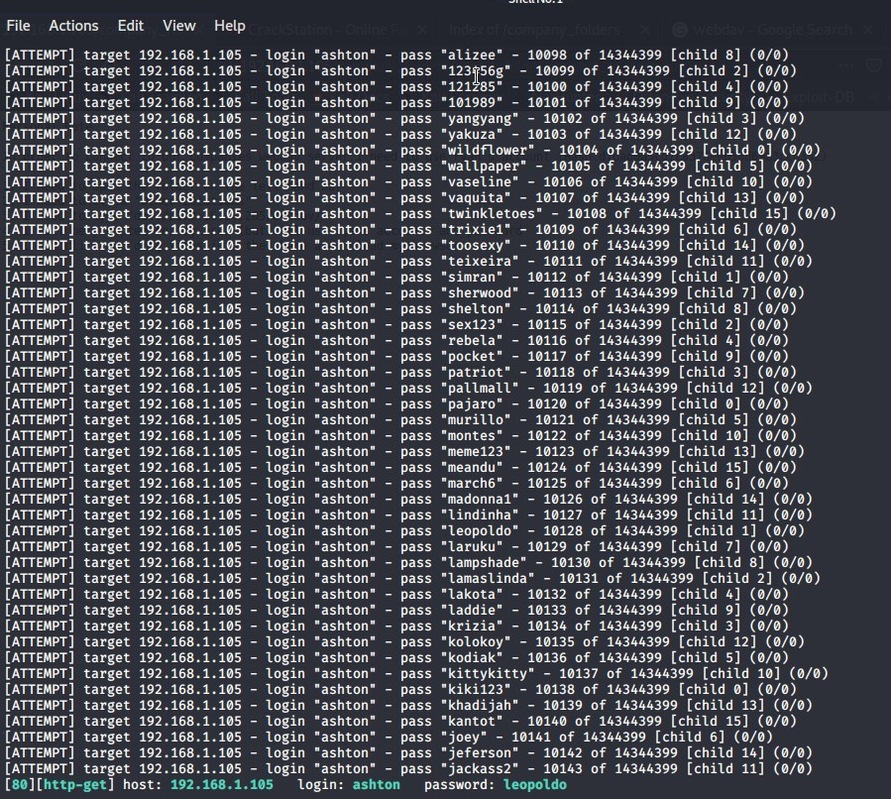
Exploitation: Brute Force Vulnerability
01
02
03
Tools & Processes
Hydra was used with a rockyou.txt wordlist to break the password for user ashton.
Achievements
This gave us the password for user ashton in order to login into the secret_folder directory.

Slide 9
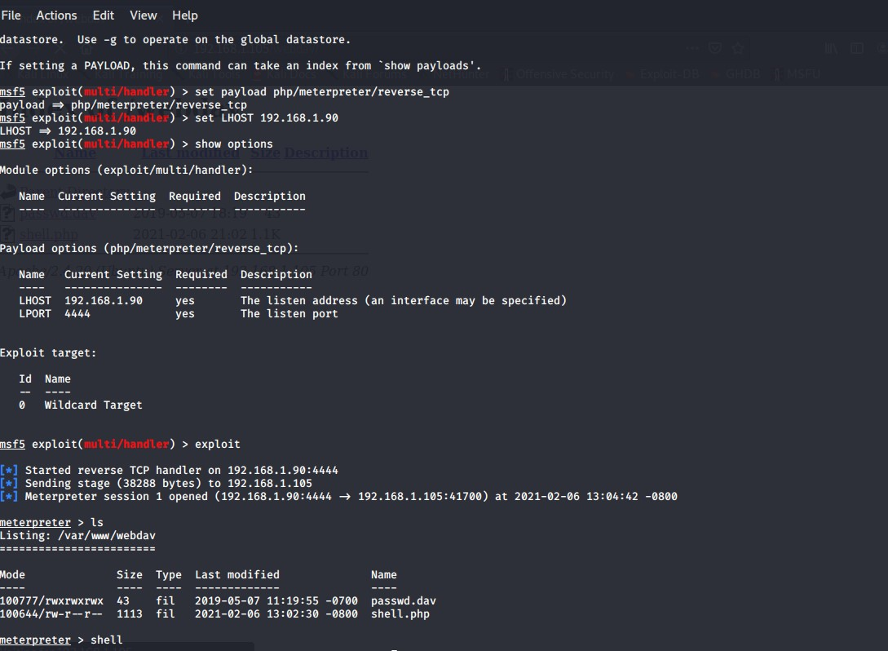
Exploitation: Reverse Shell Backdoor
01
02
03
Tools & Processes
Msfvenom was used to send a reverse tcp php payload named shell.php to the webdav server. Metasploit was then used to establish a reverse tcp shell to the capstone machine.
Achievements
This gave us a persistent root access shell to the capstone machine from the kali machine.

Slide 10
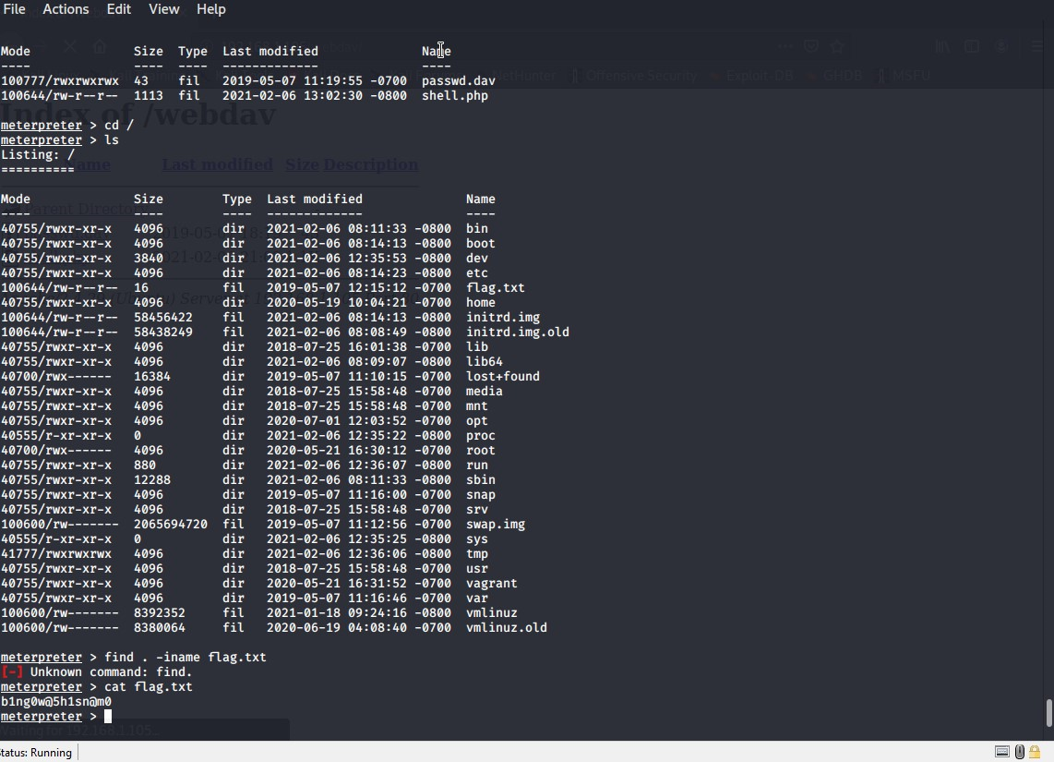
Exploitation: Remote Code Execution
01
02
03
Tools & Processes
Meterpreter was used to establish a shell on the capstone machine.
Achievements
This gave us a root access shell to execute any command and to explore the capstone machine. This would give us the opportunity to exploit any other known vulnerabilities on this machine.

Slide 11

Blue Team
Log Analysis and Attack Characterization
‹#›

Slide 12

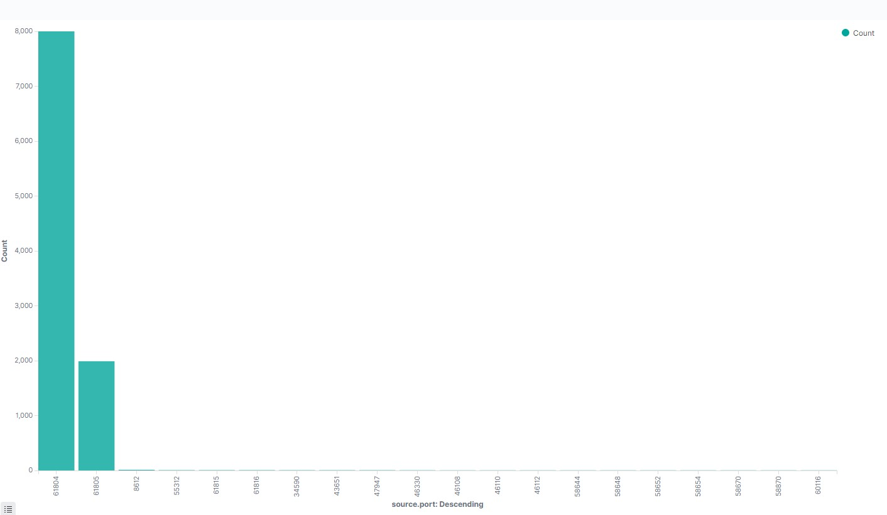
Analysis: Identifying the Port Scan
Answer the following questions in bullet points under the screenshot if space allows. Otherwise, add the answers to speaker notes.
What time did the port scan occur?
How many packets were sent, and from which IP?
What indicates that this was a port scan?
[Insert Here]
Include a screenshot of Kibana logs depicting the port scan.
Notes:
What time did the port scan occur? 2/6/21 at 1805
How many packets were sent, and from which IP? 10,112 from 192.168.1.90
What indicates that this was a port scan? Multiple port requests sent at once from non typical ports

Slide 13
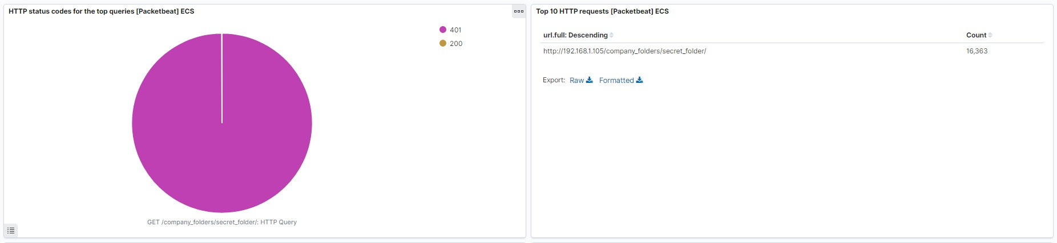
Analysis: Finding the Request for the Hidden Directory
Answer the following questions in bullet points under the screenshot if space allows. Otherwise, add the answers to speaker notes.
What time did the request occur? How many requests were made?
Which files were requested? What did they contain?
[Insert Here]
Include a screenshot of Kibana logs depicting the request for the hidden directory.
Notes:
What time did the request occur? How many requests were made? 2/6/21 at 1810, 16,363
Which files were requested? What did they contain? The file inside of the secret_folder directory named connect_to_corp_server. The file contained information on how to connect to the company webdav server, the username to use (ryan), and it contained the hash for ryan’s password.

Slide 14
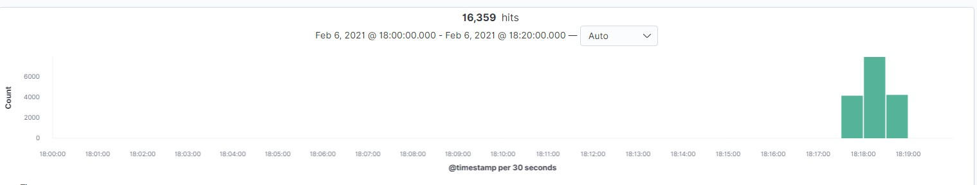
Analysis: Uncovering the Brute Force Attack
Answer the following questions in bullet points under the screenshot if space allows. Otherwise, add the answers to speaker notes.
How many requests were made in the attack?
How many requests had been made before the attacker discovered the password?
[Insert Here]
Include a screenshot of Kibana logs depicting the brute force attack.
Notes:
How many requests were made in the attack? 16,359
How many requests had been made before the attacker discovered the password? 16,354

Slide 15
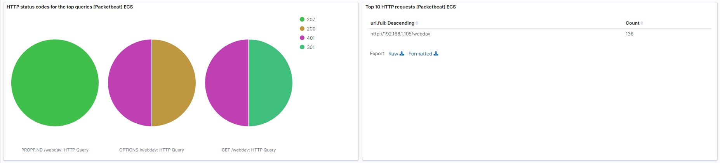
Analysis: Finding the WebDAV Connection
Answer the following questions in bullet points under the screenshot if space allows. Otherwise, add the answers to speaker notes.
How many requests were made to this directory?
Which files were requested?
[Insert Here]
Add a screenshot of Kibana logs depicting the WebDAV connection.
Notes:
How many requests were made to this directory? 136
Which files were requested? webdav/passwd.dav

Slide 16
Blue Team
Proposed Alarms and Mitigation Strategies
‹#›

Slide 17
Mitigation: Blocking the Port Scan
What kind of alarm can be set to detect future port scans?
Number of ports accessed per source ip per second
What threshold would you set to activate this alarm?
More than 50 ports per second
What configurations can be set on the host to mitigate port scans?
Firewall block all incoming and outgoing ports except for those needed (80 and 443)
Describe the solution. If possible, provide required command lines.
Change rules in IPtables to prevent traffic outside of ports 80 and 443

Slide 18
Mitigation: Finding the Request for the Hidden Directory
What kind of alarm can be set to detect future unauthorized access?
401 response codes for http://192.168.1.105/company_folders/secret_folder/
What threshold would you set to activate this alarm?
More than 5 401 response codes per hour
What configuration can be set on the host to block unwanted access?
Removing all the numerous hints as to the existence of the secret_folder directory
Describe the solution. If possible, provide required command lines.
Erase all files that have a mention to the secret_folder directory

Slide 19
Mitigation: Preventing Brute Force Attacks
What kind of alarm can be set to detect future brute force attacks?
401 response codes from user_agent.original :"Mozilla/4.0 (Hydra)"
What threshold would you set to activate this alarm?
More than 5 401 response codes per second
What configuration can be set on the host to block brute force attacks?
Require stronger more complex passwords for users and a lockout after 5 failed login attempts
Describe the solution. If possible, provide the required command line(s).
Change the server settings to require passwords to be 12 characters in length and must have complexity. Change the server settings to lock accounts after 5 failed login attempts

Slide 20
Mitigation: Detecting the WebDAV Connection
What kind of alarm can be set to detect future access to this directory?
HTTP requests from non trusted Ip’s
What threshold would you set to activate this alarm?
More than 5 HTTP requests from non trusted Ip’s
What configuration can be set on the host to control access?
Set access to only trusted Ip addresses
Describe the solution. If possible, provide the required command line(s).
Change the firewall settings to only allow trusted Ip’s to have access

Slide 21
Mitigation: Identifying Reverse Shell Uploads
What kind of alarm can be set to detect future file uploads?
HTTP PUT requests from non trusted Ip’s
What threshold would you set to activate this alarm?
More than 5 PUT requests from non trusted Ip’s
What configuration can be set on the host to block file uploads?
Set access to only trusted Ip addresses
Describe the solution. If possible, provide the required command line.
Change the firewall settings to only allow trusted Ip’s to have access

